Slide 1
Welcome to Marketing Management
Dr. Cecilia Ruvalcaba
BUSI 107 Week 3, Day 3

Slide 2
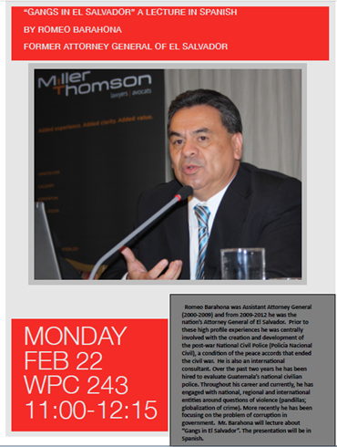

Slide 3

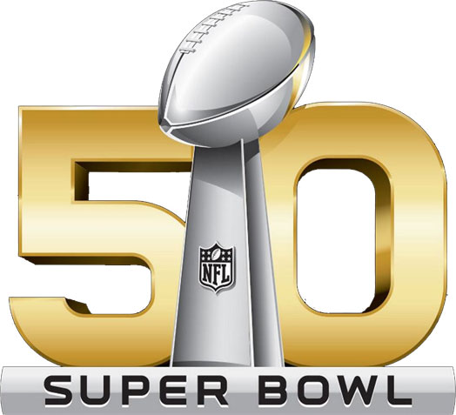

Notes:
Scion Brand to Transition to Toyota
http://pressroom.toyota.com/releases/scion+transition+toyota.htm
Toyota To Drop Scion Brand: An Experiment Ends
http://www.forbes.com/sites/stephaniebrinley/2016/02/04/toyota-to-drop-scion-brand-an-experiment-ends/#2c3d6b74644f
Super Bowl 2016: Brands turn to social for added value
http://www.marketingweek.com/2016/02/02/super-bowl-2016-brands-turn-to-social-for-added-value/?cmpid=mwbreak_1997901&utm_medium=email&utm_source=newsletter&utm_campaign=mw_daily&itx[email]=cruvalcaba@pacific.edu

Slide 4
Chapter 5: Analyzing the Marketing Environment

Slide 5
A Marketing Environment Analysis Framework
Culture
Demographics
Company
Consumers
Political/ Legal
Social
Immediate Environment
Corporate Partners
Competition
Macroenvironment
Economic
Technology

Slide 6
What is Culture?

Slide 7
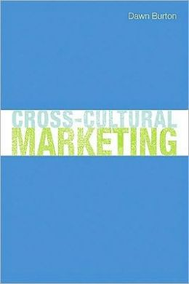


Culture
“…Ideas and activities with which we construe and construct our world.”- McCracken (1988)
“Culture constitutes the world by supplying it with meaning.”
Culture is the blueprint for interpreting actions and conveying what are acceptable mannerisms by members of the culture- Burton (2009)
Where does it come from?
Culture is learned through membership in a group or community. This includes elders, teachers, officials, experiences, and society
What does it Influence?

Slide 8
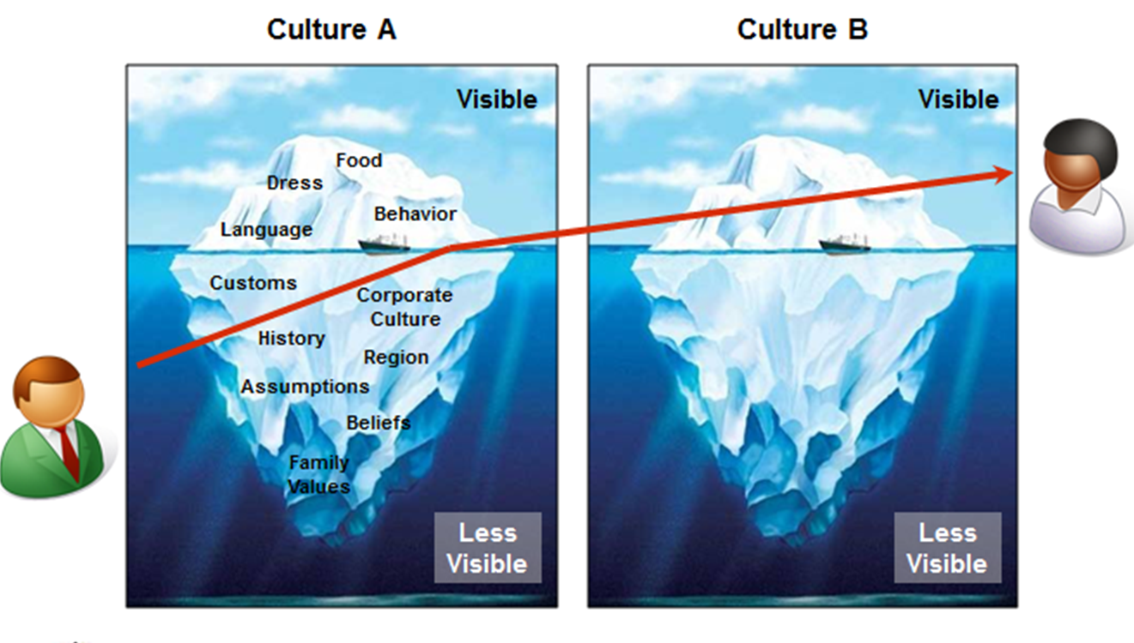
“Culture hides more than what it reveals, and strangely enough what it hides, it hides most effectively from its own participants.” -Edward T. Hall
Self Reference Criteria: Unconscious reference to one’s own cultural values
Notes:
Americans eat Exotic Asian (3:54) https://www.youtube.com/watch?v=8lK475dxZds
Koreans try U.S. food (9:53) http://www.thedailymeal.com/travel/watch-koreans-try-pop-tarts-and-other-american-snacks-first-time/012015
Americans try Australian Food (2:23) https://www.youtube.com/watch?v=ru6wri23Ljk

Slide 9

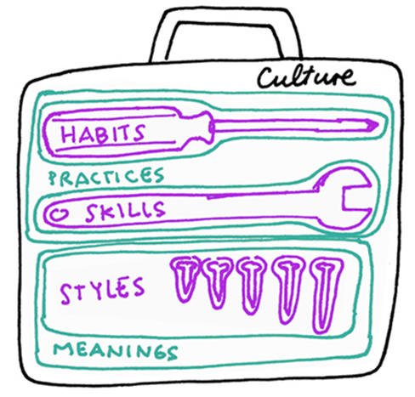
The Cultural Toolkit
Culture as a Repertoire
A set of skills and habits.- Swiddler
Culture as a reference system
“A survival kit passed down from one generation to the next.”
- Rapaille

Slide 10
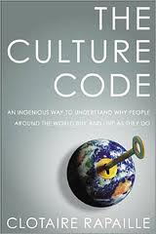
What is the Culture Code?
“The unconscious meaning we apply to any given thing via the culture in which we are raised.”- Rapaille (2006)
Is a Jeep Wrangler a Horse or a Liberator?
Open land, riding free, American. HORSE
Freedom, hope. LIBERATOR
Experience and emotion create imprints which influence us on an unconscious level.

Slide 11




Why is Culture Important?
“[Culture] is the collective programming of the mind
which distinguishes the members of one group … from
another.”- Geert Hofstede
Language, Gestures, Customs, Beliefs, Symbols
Culture’s Impact on Consumption
Culture’s impact on birth rates
Birthrates have implications for sellers of diapers, toys, schools, and colleges
Culture influences consumption of food
Diseases are influenced by culture (consumption)
Culture’s influence on home buying preferences
Size, Location, Architecture: Feng Shui
4 P’s

Slide 12


Take Away for Today
Culture is Key
Providing value requires an understanding beyond the visible surface
Be Mindful of Your and Your Customer’s SRC

Slide 13
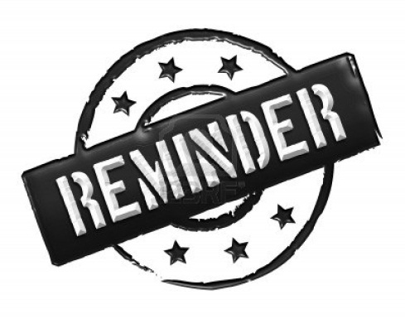
Next Class
Culture Cont…
Chapter 6: Consumer Behavior
Groups
Friday 2/12/16:
Submit Topic & Group Name
Wednesday February 22.
Library Database Session w/ Jack Schroeder

